Slide 1
Final Project
CS532 Computer Graphics
Adam Phung

Slide 2
Agenda
Introduction
Demo
Description
Maze Generator
Camera movement
Looking around
Camera adjustments
HUD

Slide 3
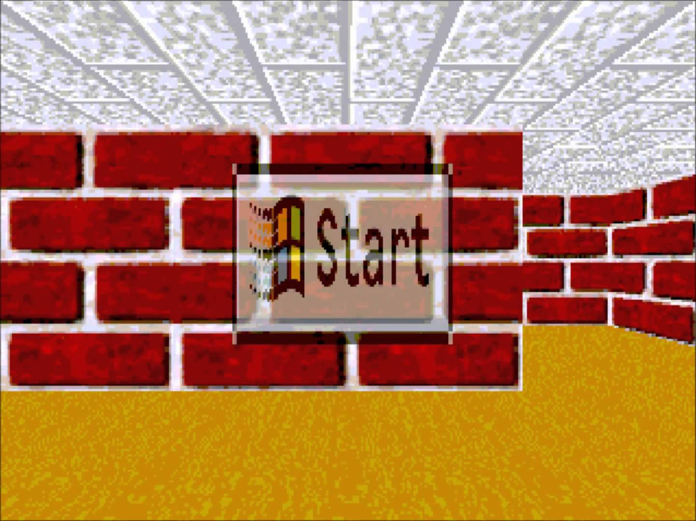
Introduction
First Person Maze inspired by old Windows screensaver

Slide 4
Demo

Slide 5
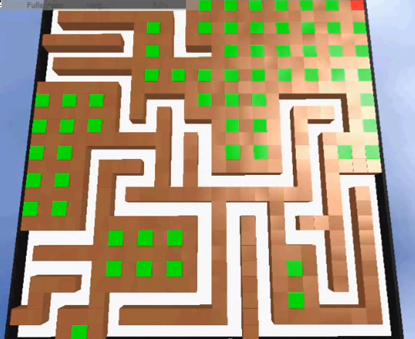
Maze Generator
Recursive backtracking algorithm
http://www.youtube.com/watch?v=8_qHpAAZCPI

Slide 6
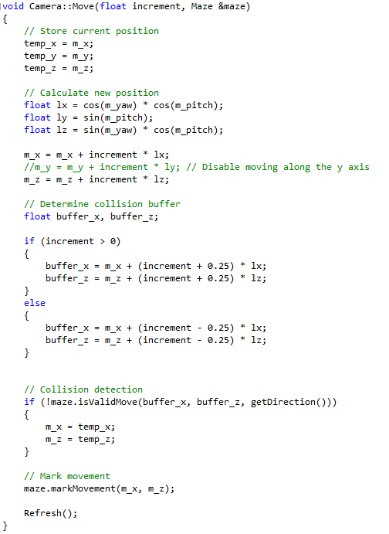
Camera - Translation
Determine where the camera will be after movement

Slide 7
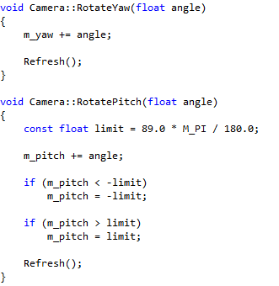

Camera - Free look
Movement with the mouse to look up, down and around the camera

Slide 8
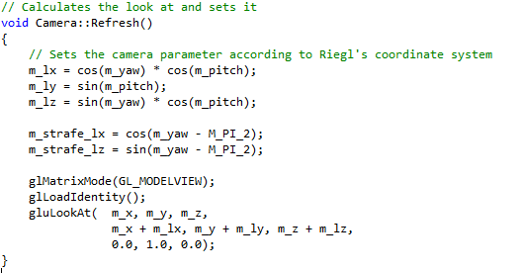
Camera – Look
Determine where the camera should be looking

Slide 9
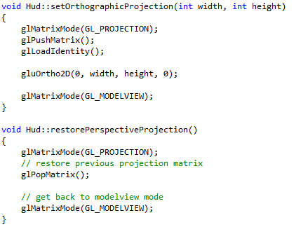
Heads Up Display (HUD)
Switches projection mode from Perspective to Orthographic to display screen elements then switches back to render the rest of the scene

Slide 10
Questions?

